Slide 1
Programs of HUD
Major Mortgage, Grant, Assistance, and Regulatory Programs

Slide 2
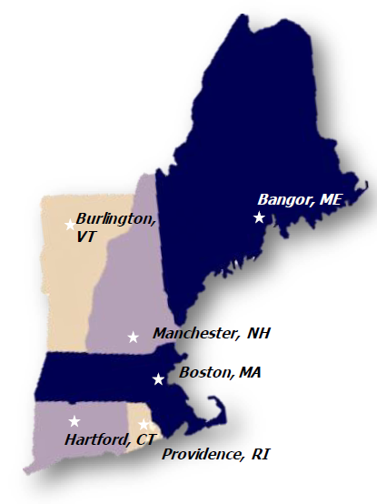
“Inside” HUD New England Region 1
6 Field Offices:
Massachusetts, Maine, Connecticut, Rhode Island, Vermont, and New Hampshire
8 Internal Departments:
FPM, CPD, FHEO, PIH, Housing (Single Family and Multi-Family), OIG, RC, ADMN, PD&R, Lead & Healthy Homes
Staffing:
190 employees across the region, majority located in
our Boston office
Total Regional Funding
FY23 and FY24 total | $9.5 billion

Slide 3
Bangor, ME Field Office (FPM) Jennifer Boardman State Director Gary Fearon Program Analyst Ann Martin Management Analyst
WHAT IS FPM?
Your primary contact for services, information & inquires
HUD’s “General Issues” Community Liaison & Customer Service Response
WHAT DOES FPM DO?
First point of contact in the State of Maine for any housing related questions or concerns addressed to HUD from constituents or representatives of constituents.
Coordinate and ensure all housing resources are activated during disasters, fires and floods by working with FEMA and local/state government.
Regional and Field Offices work with community stakeholders, public agencies and locally elected officials to communicate priorities and policies of the HUD Secretary
Develop relationships with other federal agencies to leverage resources for our communities
Help identify local housing and community development needs
Recruit partners and identify HUD and non-HUD resources to help meet community needs

Slide 4
HUD Office’s
Offices of the Secretary & Deputy Secretary
Community Planning & Development (CPD)
Office of Housing
Public and Indian Housing (PIH)
Fair Housing and Equal Opportunity
Policy Development and Research (PD&R)
Field Policy and Management (FPM)
Government National Mortgage Association (Ginnie Mae)
Lead Hazard Control and Healthy Homes Program
*FEMA

Slide 5
HUD's mission is to create strong, sustainable, inclusive communities and quality affordable homes
Prior Administration (Biden/Harris) Strategic Priorities:
Support historically underserved communities & equitable community development.
Increase supply of and access to affordable housing.
Address homelessness with the urgency it requires.
Promote homeownership opportunities and wealth building.
Advance sustainable communities, climate resilience, and environmental justice.
Strengthen HUD’s internal capacity to deliver its mission.

Slide 6
What is HUD’s Office of Community Planning and Development (CPD)?
CPD provides critical resources to:
boost housing supply
increase access to affordable housing
promote homeownership
fund public and supportive services
invest in community development
create jobs and support small businesses
upgrade infrastructure and neighborhood amenities
support individuals experiencing or at risk of homelessness
increase community resilience / disaster recovery
provide technical assistance and capacity building resources
PHOTO CREDIT: NEW GRANDA SQ. PITTSBURGH

Slide 7
CPD Program Highlights
Homelessness
Continuum of Care (Coc)***
Affordable Housing and Community Development
HOME* and HOME-ARP**
Housing Trust Fund* (HTF)
Community Development Block Grant (CDBG) Grants* and CDBG-CV**
Recovery Housing Program (RHP)*
Emergency Solutions Grants (ESG)* and ESG-CV**
Housing Opportunities for Persons with AIDS (HOPWA) grants* and HOPWA-CV**
PRO-Housing Grants***
PRICE Grants***
Disaster Recovery
CDBG Disaster Recovery (CDBG-DR) and Mitigation (CDBG-MIT)**
Community Project Funding
Economic Development Initiative – Community Project Funding (CPF) Grants****
Key: *Formula **Supplemental ***Competitive ****Congressionally Directed

Slide 8
Key Formula Grant Points:
Awarded annually by block grant for specific purposes, each with own set of regulations.
Awarded directly to states, cities, and counties.
Not all grantees receive all grants. Grants are awarded based on population size and thresholds.
CPD does not approve specific activities or projects; the grantees plan, select and certify they are eligible – we verify!

Slide 9
What can you do with CDBG?
Housing
Public Facilities
Economic Development
Public Infrastructure
Planning and Administration
Other

Slide 10
State of Maine
Dept of Economic and Community Development
CDBG
State decides which agencies will administer funding
Each funding source used for state goals & priorities
State of Maine CDBG Grant
Categories
RHP
HTF
Maine State Housing Authority (MaineHousing)
HOME
ESG
CPD Awards Funds to State
Community Development
Economic Development
Planning
State of Maine and CPD Funds
State of Maine CDBG Annual Grant Allocation for FY2024: $11,808,636

Slide 11
Maine Entitlement Communities and Allocations
FY 2024 Community Planning and Development Formula Program Allocations
NAME | STA | CDBG | RHP | HOME | ESG | HOPWA | HTF
State of Maine | ME | $11,808,636 | $1,267,575 | $3,893,165.00 | $1,391,803 | $0 | $3,144,833.37
Auburn | ME | $508,342 | $0 | $428,732.84 | $0 | $0 | $0
Bangor | ME | $821,802 | $0 | $0 | $0 | $0 | $0
Biddeford | ME | $393,621 | $0 | $0 | $0 | $0 | $0
Lewiston | ME | $788,093 | $0 | $0 | $0 | $0 | $0
Portland | ME | $1,833,541 | $0 | $839,923.23 | $161,998 | $0 | $0
Cumberland County | ME | $1,556,118 | $0 | $0 | $0 | $0 | $0
Entitlement Communities automatically receive annual funding

Slide 12
State of Maine CPD Program Contact Information
Department of Economic & Community Development (CDBG):
Deborah Johnson, Director
Department of Economic & Community Development
59 State House Station
Augusta, ME 04333-0059
deborah.johnson@maine.gov
Phone: (207) 624-9817

Slide 13
CPD Questions and Resources
•Go to: www.hudexchange.info/grantees for specific grantee information.
•Go to: www.hudexchange.info/programs for more details regarding CPD programs.
•Go to: https://cfo.gov/grants/training/ for Grants 101, an online course that covers the requirements for doing business in the Federal Sector.
• CPDQuestionsAnswered@hud.gov
• The Ask A Question desk: https://www.hudexchange.info/program-support/my-question/
• Disease Risks and Homelessness - HUD Exchange

Slide 14
Office of Housing
Office of Housing provides essential support to the nation's housing economy, homeowners, renters and communities. Its major programs provide FHA mortgage insurance for single-family homes, multifamily properties, healthcare facilities, including the elderly and people with disabilities.
Since the start of the Biden-Harris Administration, FHA has supported nearly 1.8 million homeowners with purchase mortgages, and 83.6 percent or 1.5 million of whom are first-time homebuyers.
The Office of Housing Counseling: provides support to renters, homeowners, and home buyers with a variety of services in the homeownership process.
Program | FY23 | FY24 (6 months)
First Time Home Buyer | 110,064 | 47,866
Minority First Time Home Buyer | 33,016 | 7,519
FY24 Sub-Awards (Maine) | Total
Housing Counseling (6 Agencies) | $238,662

Slide 15
Housing Counseling
WHAT IS HOUSING COUNSELING?
Provides support to a nationwide network of Housing Counseling Agencies (HCA’s) and counselors
WHAT DOES HOUSING COUNSELING DO?
Housing Counseling Agencies are trained and approved by HUD to provide tools to current and prospective homeowners, renters so that they can make responsible choices to address their housing needs in light of their financial situations.
Find a Housing Counselor
Home
Phone: (800) 569‐4287 | TTY: (202) 708‐1455
Maine Housing Counseling Agencies
Avesta Housing Development Corporation
Coastal Enterprises, Incorporated
Community Concepts, Inc.
Four Directions Development Corporation
Kennebec Valley Community Action Program
Penquis Community Action Program

Slide 16
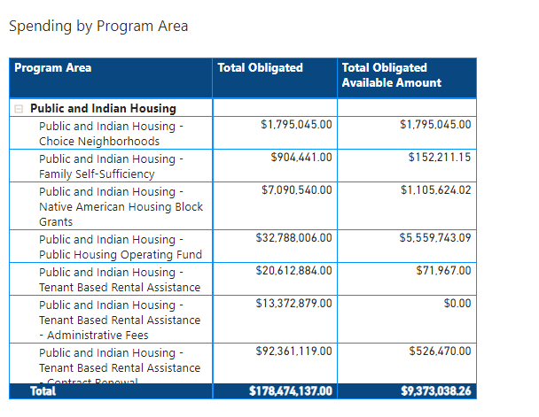
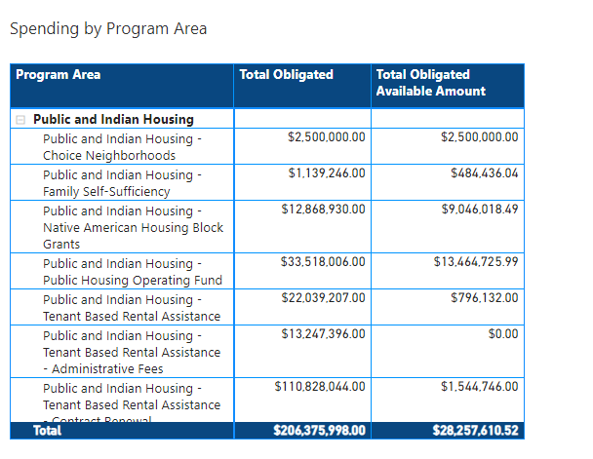
Office of Public and Indian Housing
Oversees and monitors the Housing Choice Voucher and Public Housing programs which ensure affordable housing accessibility to the most vulnerable and disadvantaged households.
Implements self-sufficiency programs (ROSS, FSS, JobsPlus), RAD, PHA’s health and hazard and Choice Neighborhoods grants.
Lewiston Housing Authority was just awarded $1.25 million for lead hazard remediation
12,163 units currently leased in Maine.
Data as of 1/8/25, 6:14 AM Filtered by Program Area (is Public and Indian Housing), State (is Maine), Year (is greater than or equal to 2024 and is less than or equal to 2024), Workspace (is CFO Systems Financial)
FY23
FY24
Notes:
Targeted Vouchers: Mainstream (non-elderly disabled), Family Unification, Veterans Affairs Supportive Housing (VASH)
TBRA: Section 8 Vouchers and admin fees

Slide 17
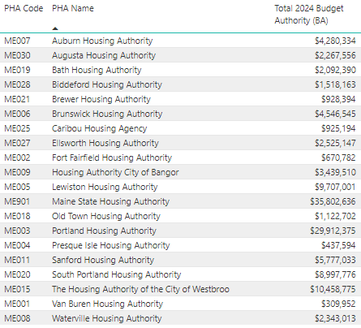
Office of Public and Indian Housing FY24 PHA Allocations

Slide 18
Office of Public and Indian Housing (PIH)
PIH Customer Service Center:
(800) 055-2232 (Toll Free)
Hours of Operation 9 am – 5 pm (EST)
Monday – Friday, except for Federal Holidays

Slide 19
Office of Multifamily Housing
Oversees and monitors Project-Based Rental Assistance program, which provides safe and affordable housing for low and very low-income households in privately owned developments.
Administers the elderly housing (Section 202) and persons with disabilities (Section 811) programming.
During the Biden-Harris Administration, MFH has released 2 NOFOs for Section 202 and 3 NOFOs for Section 811.
Notes:
Talking point – PBRA no new PRAC but this is an opportunity to reconsider give private landlords subsidized units

Slide 20
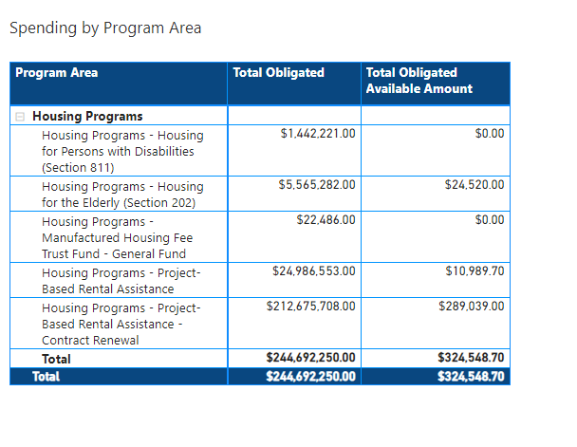
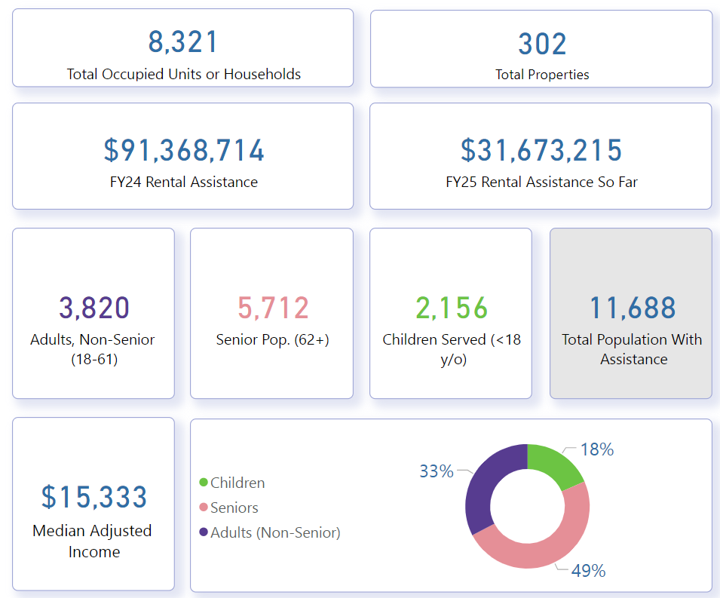
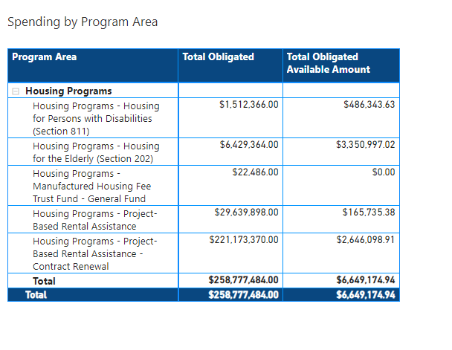
Multifamily Housing – Maine Numbers
FY23
FY24

Slide 21
Multifamily Housing: Section 202 & 811 Overview
Section 202: Provides rental assistance for elderly (One member must be 62 and older) households with very low income
Section 811: Provides affordable housing to very low‐and extremely low‐income individuals with serious and long‐term disabilities, including physical or developmental disabilities, as well as mental illness
Current programs meet only a portion of the need for affordable housing among these special populations

Slide 22
Office of Fair Housing and Equal Opportunity
The FHEO office works to eliminate housing discrimination, promote economic opportunity, and create diverse communities through enforcing the Fair Housing Act of 1968.
The FHA provides protections against discrimination on the basis of race, religion, national origin, sex (including sexuality and gender orientation), disability, and familial status.
Administers funding to nonprofits across the region to assist in the enforcement of the Fair Housing Act.
In FY24 the FHEO office received 2,000 requests for assistance with discrimination. Of these 391 triggered investigations.
Resulting in 8 settlements, totaling $45,000 in compensation to 15 complainants .
FY23 and FY24 | Obligated | Available
Fair Housing | $8,551,687 | $3,637,962

Slide 23
Office of Fair Housing and Equal Opportunity Maine Statistics
Fair Housing Initiatives Program (FHIPs) are non-profit agencies that represent victims, do outreach, and conduct testing. HUD provides and monitors their grants.
https://www.hud.gov/program_offices/fair_housing_equal_opp/partners/FHIP
Pinte Tree Legal Associates: $1,885, 000 in the last four years across two three-year grants to prevent or eliminate discriminatory housing practices.
Fair Housing Assistance Programs (FHAP’s) are state or municipal agencies that investigate complaints. They must enforce a law substantially similar to the Fair Housing Act. HUD pays for completed cases, whether initiated at the FHAP, or at HUD Intake and referred for state investigation. The FHAP can also investigate additional state law violations within the same case, under their state funding.
https://www.hud.gov/program_offices/fair_housing_equal_opp/partners/FHAP
MHRC: $191,000 in case payments and grants for administration last year. This is a typical amount for a year of FHAP work in Maine.
When a FHAP can’t investigate a case, HUD keeps it at FHEO.
This could be for some technicality that prevents the FHAP from enforcing the Fair Housing Act https://www.hud.gov/program_offices/fair_housing_equal_opp/fair_housing_act_overview, or because the allegations implicate one of our laws that apply to recipients of federal assistance; the ADA, Section 504, Title 6 of the Civil Rights Act of 1964, Section 109 of the Housing and Community Development Act of 1074, and VAWA, are the most common.
The Fair Housing Act covers race, color, national origin, religion, sex (incl. LGBTQ), familial status (the presence of children), and disability, as well as retaliation for reporting those violations.
In FY 2024, we processed 280 cases between HUD and MHRC combined.
Here’s an example of a case FHEO investigated and found reasonable cause to charge, last spring in Maine. It’s currently being litigated by DOJ because the parties weren’t able to reach a settlement, and respondents “elected” to remove it from the HUD process to federal court. https://www.justice.gov/d9/2024-06/complaint_methuselah_tree-final.pdf

Slide 24
Office of Fair Housing and Equal Opportunity
FHEO remains open, accepting and investigating allegations of discrimination filed by the public online, by email, or by phone. You can speak with an FHEO intake specialist by calling 1‐800‐669‐9777 or 1‐800‐877‐8339 for TTY. To file online and for more information please visit HUD-903 Report Housing Discrimination

Slide 25
Policy Development and Research (PD&R)
Distressed Cities Technical Assistance (DCTA) - This initiative competitively awards technical assistance funding to organizations to provide technical assistance and capacity building for local governments and their nonprofit partners.
Eligible activities for technical assistance providers implementing DCTA include the following: (1) needs assessments; (2) direct technical assistance and capacity-building engagements; (3) development of products and tools; and (4) self-directed and group learning (training).
Thriving Communities Technical Assistance Program - This initiative competitively awards technical assistance funding to organizations to provide technical assistance and capacity building for units of local governments and their partners around transit-oriented development.
Eligible activities for Thriving Communities include (1) needs assessments; (2) direct technical assistance and capacity-building engagements; (3) development of products and tools; and (4) self-directed and group learning (training).
Community Compass Technical Assistance & Capacity Building Program- helps HUD's customers navigate complex housing and community development challenges by equipping them with the knowledge, skills, tools, capacity, and systems to implement HUD programs and policies successfully.
Eligible Activities include:
Needs assessments
Direct Technical Assistance and Capacity Building engagements
Development of products and tools
Self-directed and group learning
Knowledge management
Data reporting, analysis and management
NAHASDA allocation formula administration and negotiated rulemaking support

Slide 26
DCTA Eligible Applicants in Maine
Local Governments must meet at least one of the following criteria below.
Annual average unemployment rate of 9% or more over the past 3 years
A noncollege poverty rate of 20% or more as of the most recent 5-year ACS survey
A population decline of 5% or more between 2010 and the most recent 5-year ACS survey
Franklin County (includes all towns/cities)
Washington County (includes all towns/cities)
Auburn
Bangor
Calais
Gardiner
Lewiston
Old Town
Waterville
Caribou
Presque Isle

Slide 27
Office of the Secretary & Deputy Secretary
VAWA - The Violence Against Women Act (VAWA) - Among other things, provides housing protections for survivors of domestic violence, dating violence, sexual assault, and stalking.
Self Help Housing Property Disposition Program - This program makes surplus Federal properties available through sale at less than fair market value to States, their subdivisions and instrumentalities, and nonprofit organizations.

Slide 28
Lead Hazard Control and Healthy Homes Program
Capacity building and technical assistance; grants for the development of local programs to address housing-related health and safety hazards; demonstration projects and research, outreach and education authority related to lead hazard control and healthy homes issues; enforcement of the Lead Safe Housing Rule and the Lead Disclosure Rule.
Maine Lead Hazard Reduction Grant Awards
FY24 – City of Lewiston - $7,750,000
FY24 – City of Portland - $3,367,960
FY25 – Maine State Housing Authority - $2,000,000
Fy25 – Pleasant Point Passamaquoddy Tribe - $1,000,000

Slide 29
FEMA Mission
The Federal Emergency Management Agency (FEMA) and the U.S. Department of Housing and Urban Development (HUD) work together to help communities recover from disasters and mitigate housing recovery challenges:
FEMA's mission
FEMA's mission is to help people before, during, and after disasters. FEMA provides assistance to individuals, governments, and private non-profits. FEMA's core values are compassion, fairness, integrity, and respect.
HUD's role
HUD works with FEMA to address housing recovery challenges before disasters strike. HUD and FEMA are developing tools to help communities plan for housing shortfalls before disasters.
Benefits of the partnership
The partnership between FEMA and HUD helps communities recover more quickly from disasters. For example, if a home becomes unlivable due to a disaster, HUD-assisted renters may be eligible for temporary housing assistance from FEMA.

Slide 30
FEMA Declared Recent Disasters in Maine
Maine Severe Winter Storm (DR-4785-ME) – April 3,2024
Maine Severe Storms and Flooding (DR-4764-ME) – January 9, 2024
Maine Severe Storm and Flooding (DR-4754-ME) – December 17, 2023
Maine Hurricane Lee (EM-3598-ME) – September 15, 2023
Maine Severe Storm and Flooding (DR-4737-ME) – June 26, 2023
Maine Severe Storm and Flooding (DR-4736-ME) – June 29, 2023

Slide 31
Any Questions?

Slide 32
Contact Information
Jennifer Boardman – State Director
Jennifer.l.boardman@hud.gov (207) 262-0246
Gary Fearon – Program Analyst
Gary.j.Fearon@hud.gov (207) 249-7377
Ann Martin – Management Analyst
Ann.c.martin@hud.gov (207) 262-0310

