Slide 1

Housing Data Analysis and Methodologies
Charlotte Nutt
Midcoast Council of Governments
Charlotte Nutt Dataworks

Slide 2
Today’s schedule:
State and MCOG’s housing needs studies (gaps analysis)
Application to towns
Next steps for MCOG’s data
Questions

Slide 3
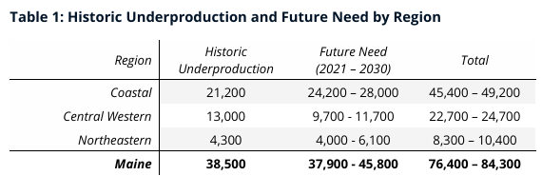
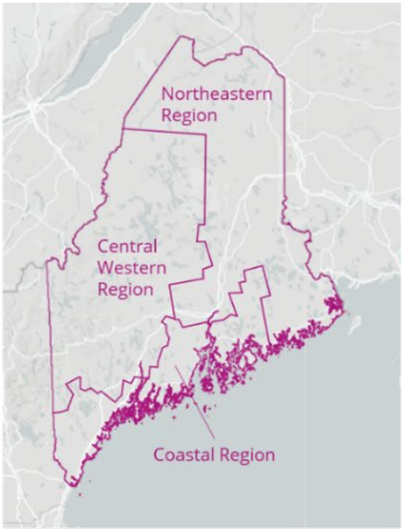
State Housing Production Needs Study (Oct 2023)
The data was further broken down by county and income, but this was a challenge for our communities

Slide 4
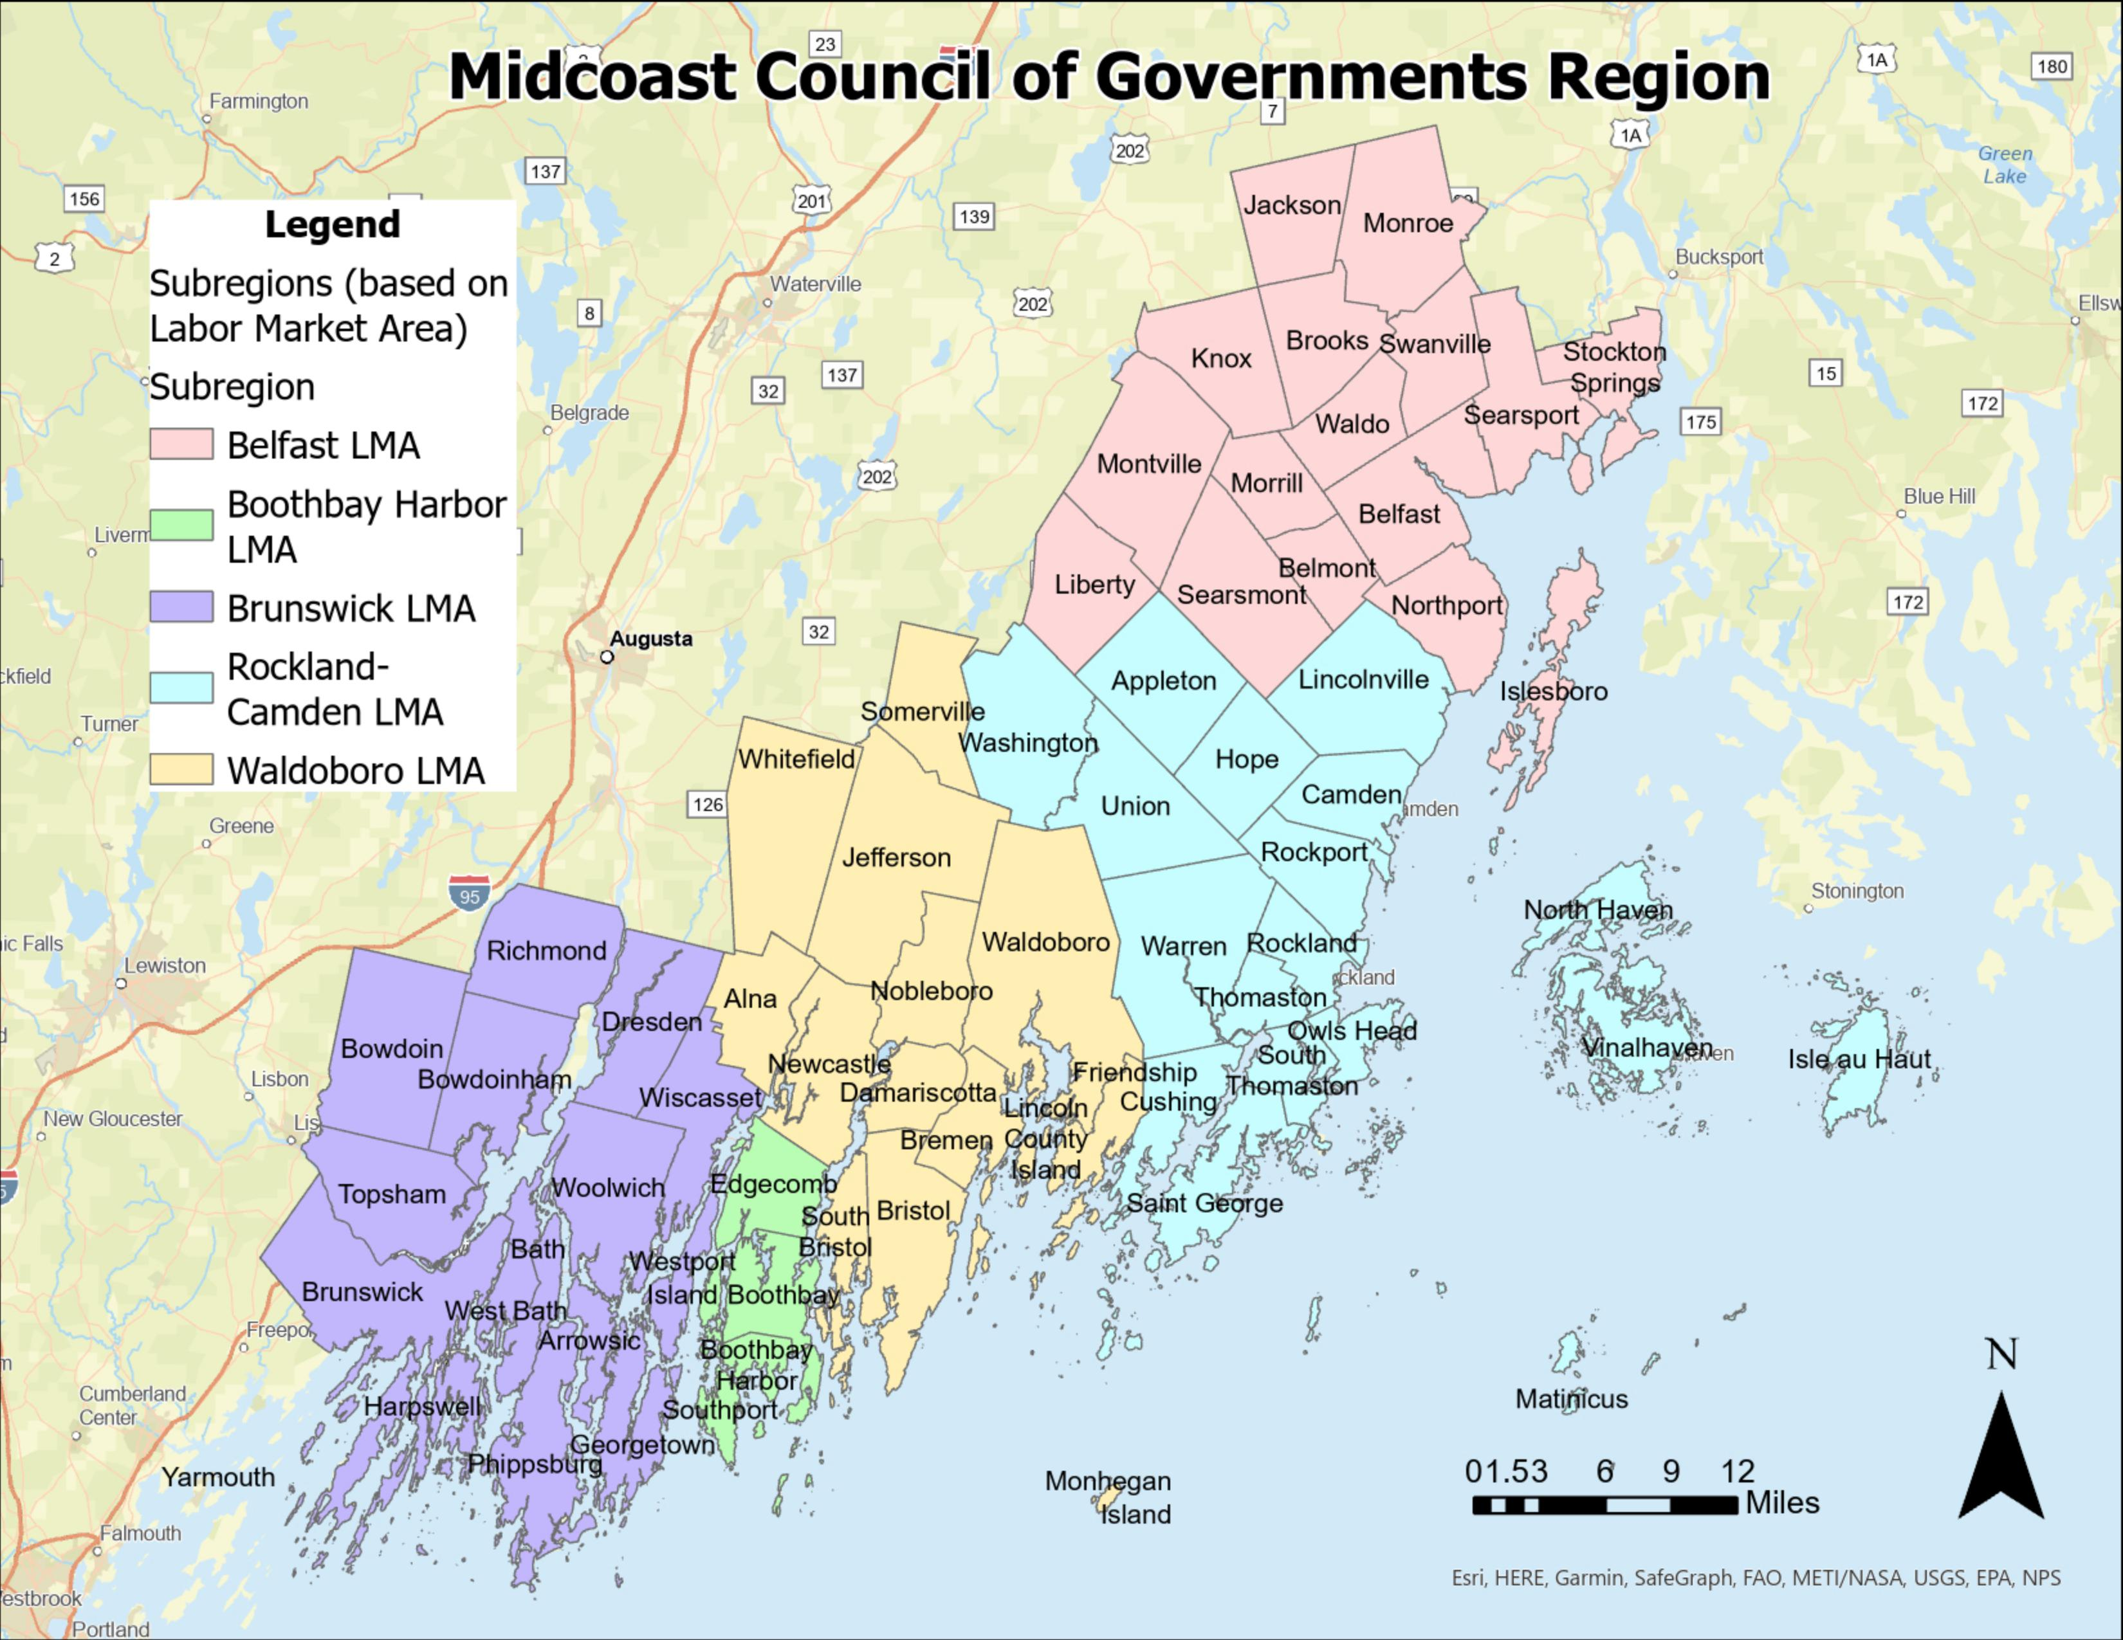
Data work around Labor Market Areas: cohesive geographies where people live and work
E.g. Brunswick and Harpswell are in Cumberland County, which is overshadowed by Portland Metro

Slide 5
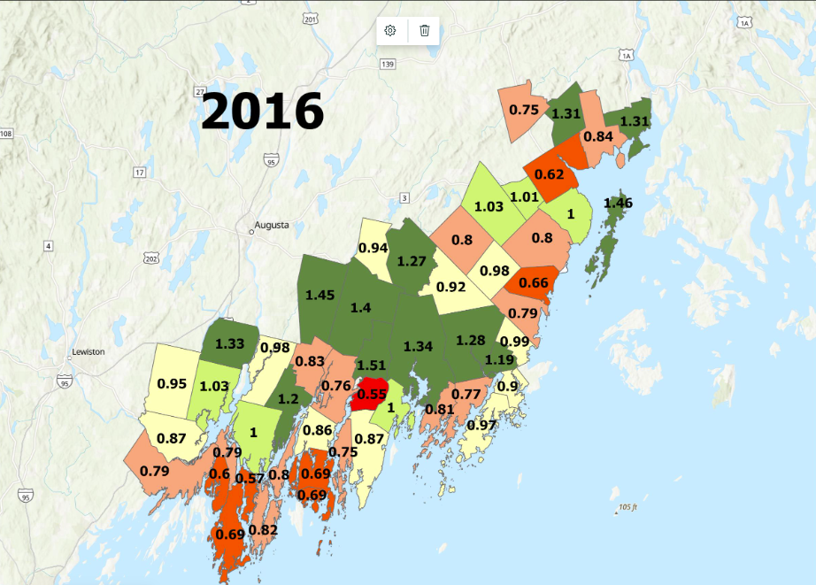
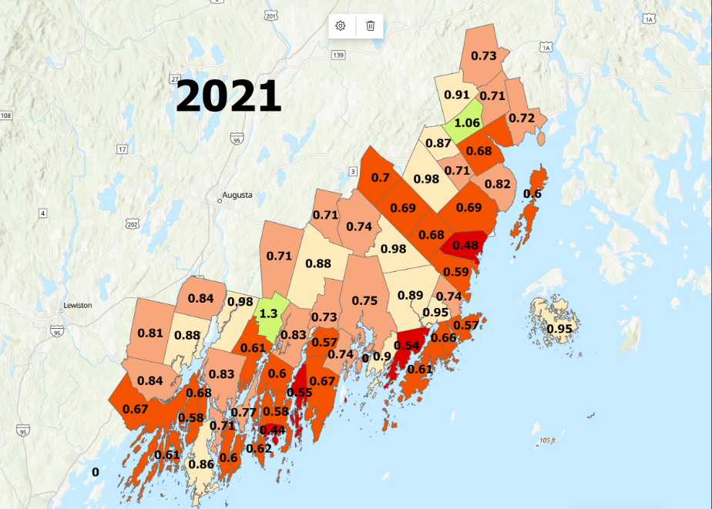
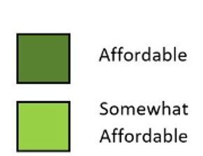
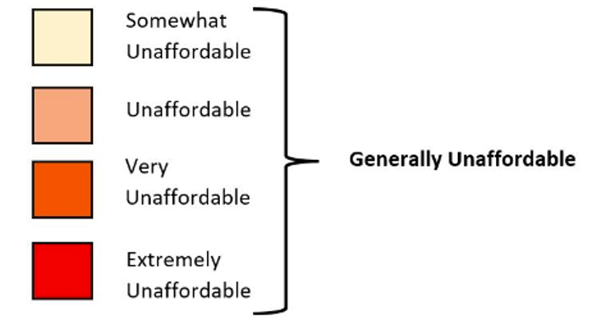
Housing Affordability Index
The Homeownership Affordability Index is the ratio of Home Price Affordable at Median Income to Median Home Price.
Generally Affordable
Generally Unaffordable

Slide 6
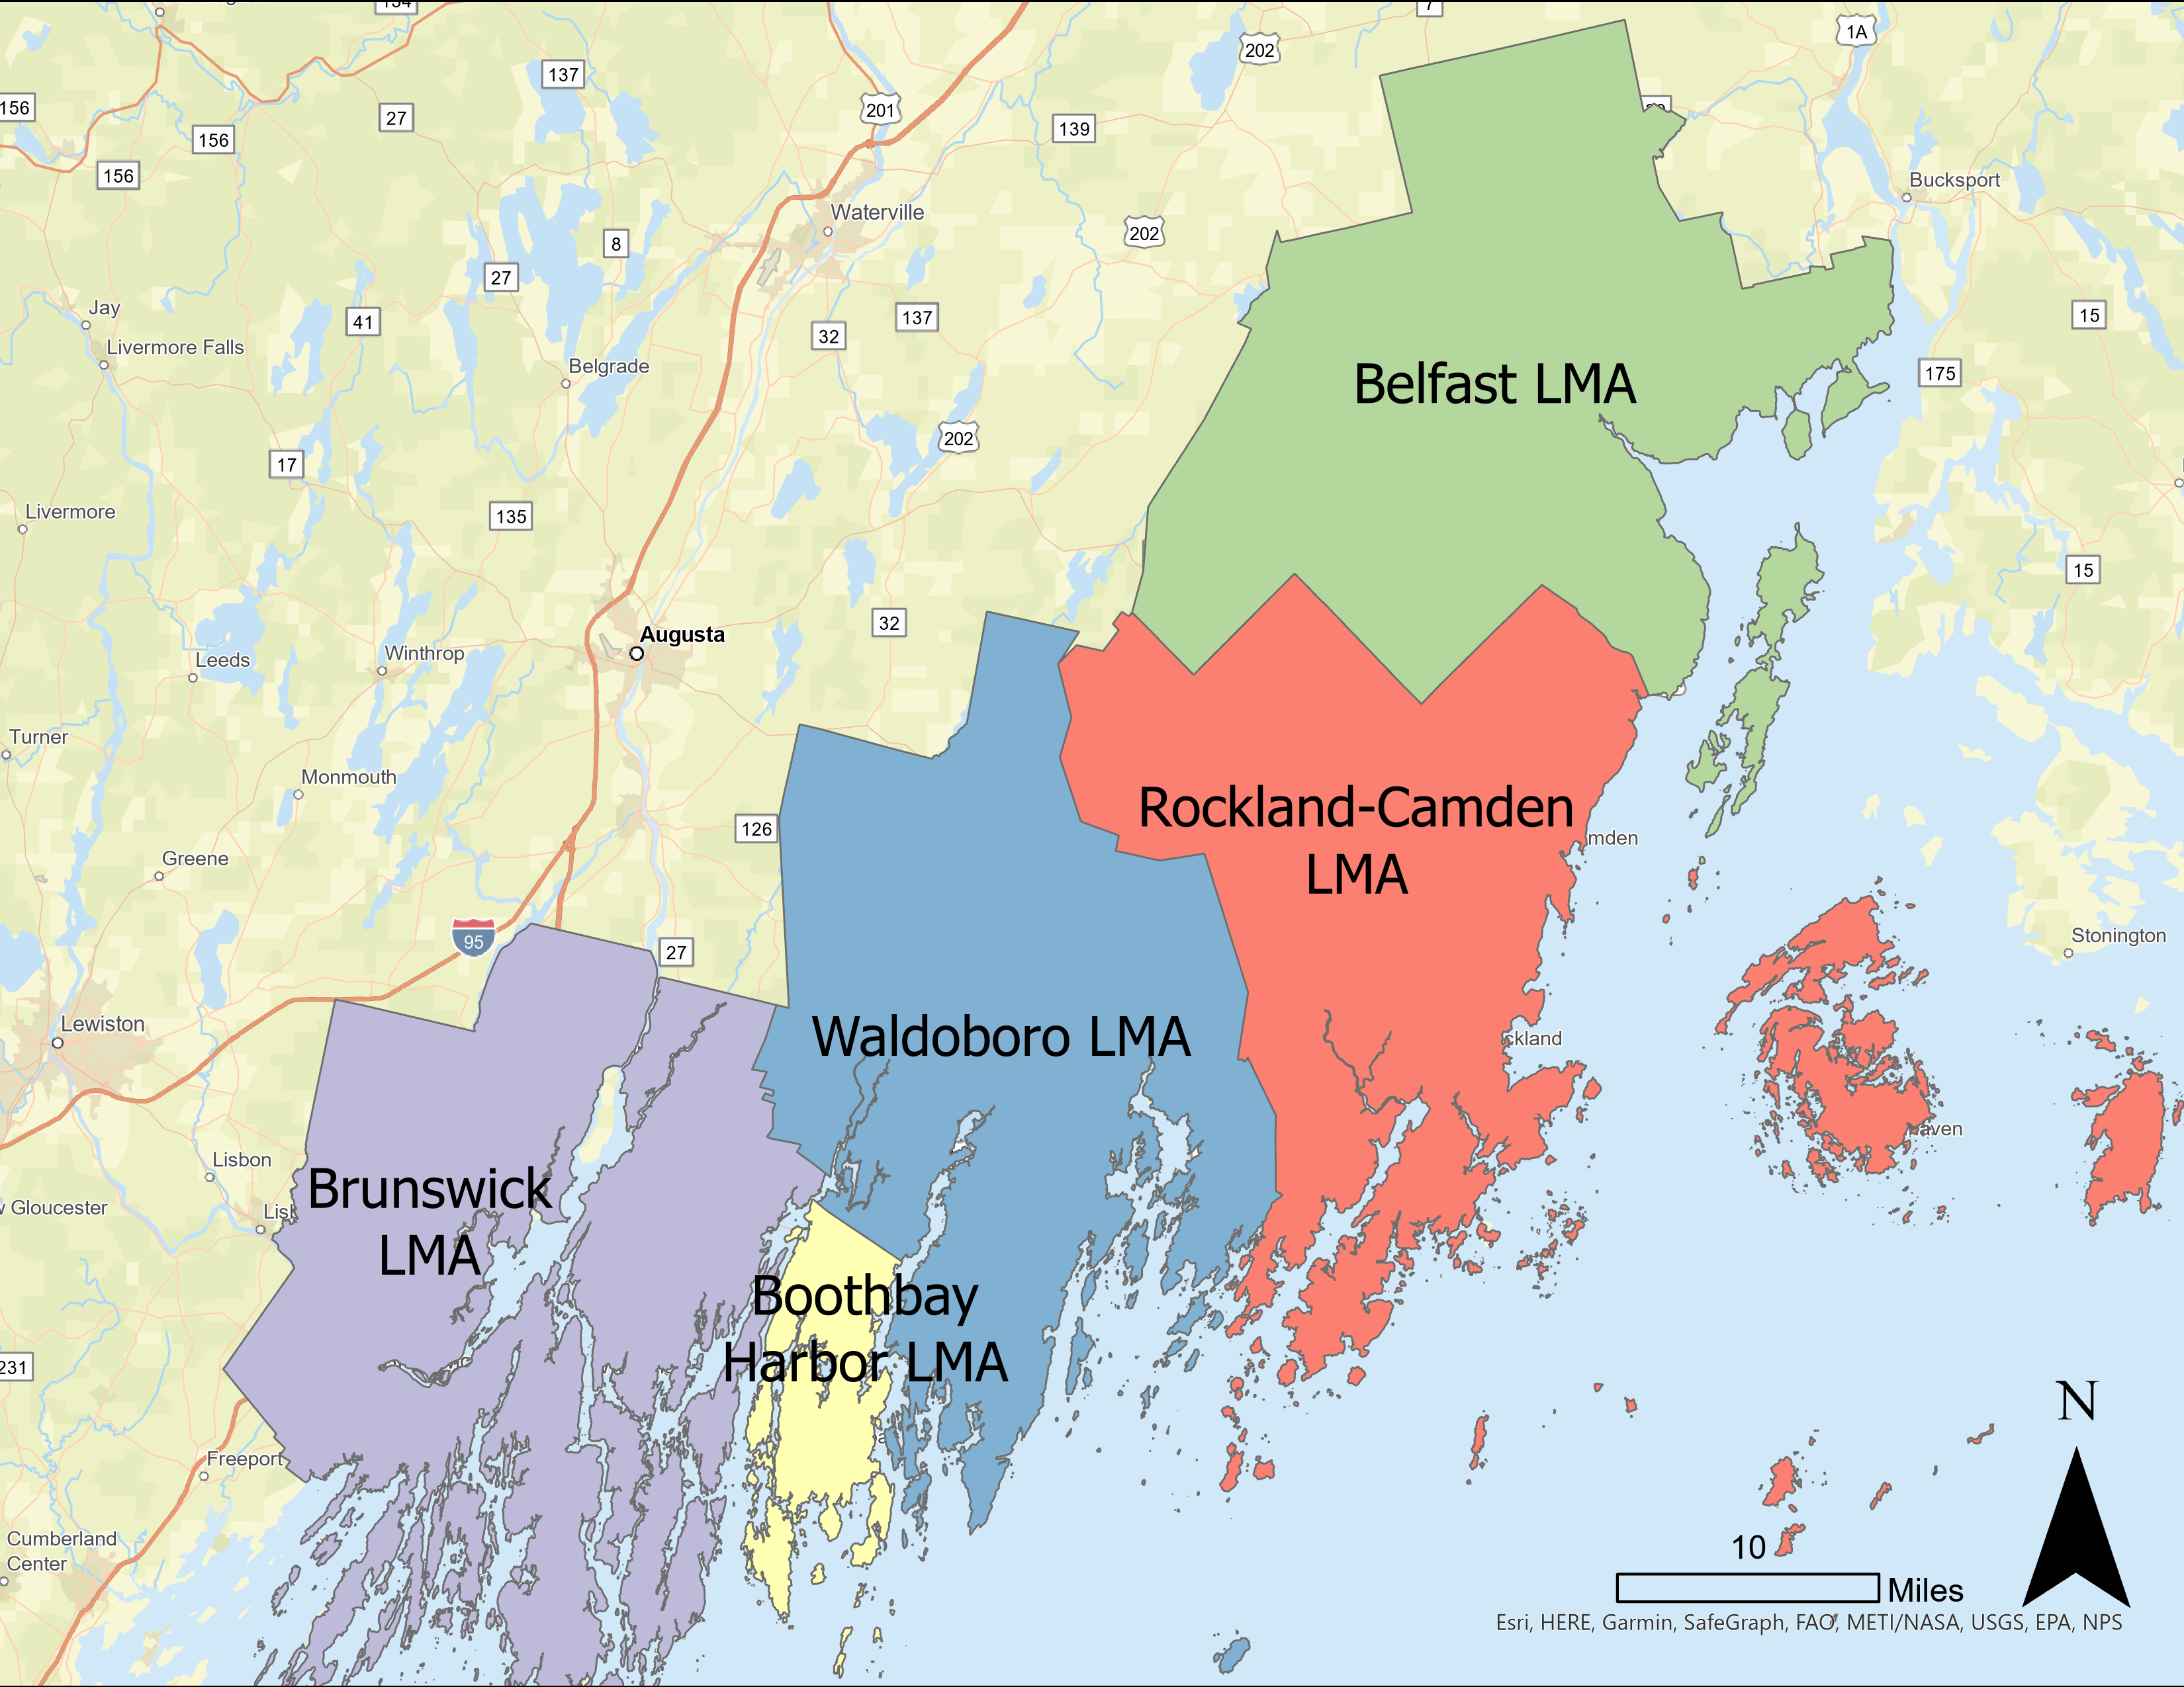
Housing Gap Analysis
Methodology from Maine State Housing Production Needs Assessment
Based around Labor Market Areas (LMA’s)
Aim: identify the number of housing units needed by
  Labor market area
  Household income
  Rental vs owned property needs
Adjusted to affordability

Slide 7
Housing Gap Analysis: Methodology
Methodology
Adapted from the State of Maine Housing Production Needs Study from October 2023
Data is from American Community Survey 5-Year Census and Maine Housing
Assumptions
5% housing availability rate
5% unemployment rate

Slide 8
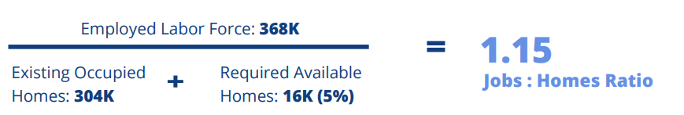
Housing Gap Analysis: Measuring Current Shortage
Housing shortage
Measured number of occupied units and number of available units
Calculated the number of “missing” available units needed to get to 5% of occupied units
Jobs Shortage and Jobs : Homes Ratio
Measured number of employed and number of unemployed workers
Calculated the number of “missing” workers needed to get to 5% unemployment
Calculated Jobs : Homes ratio, or how many homes are needed per new job
81K
1.07
72K
1K
Figure and equation from the State of Maine Housing Production Needs Study

Slide 9
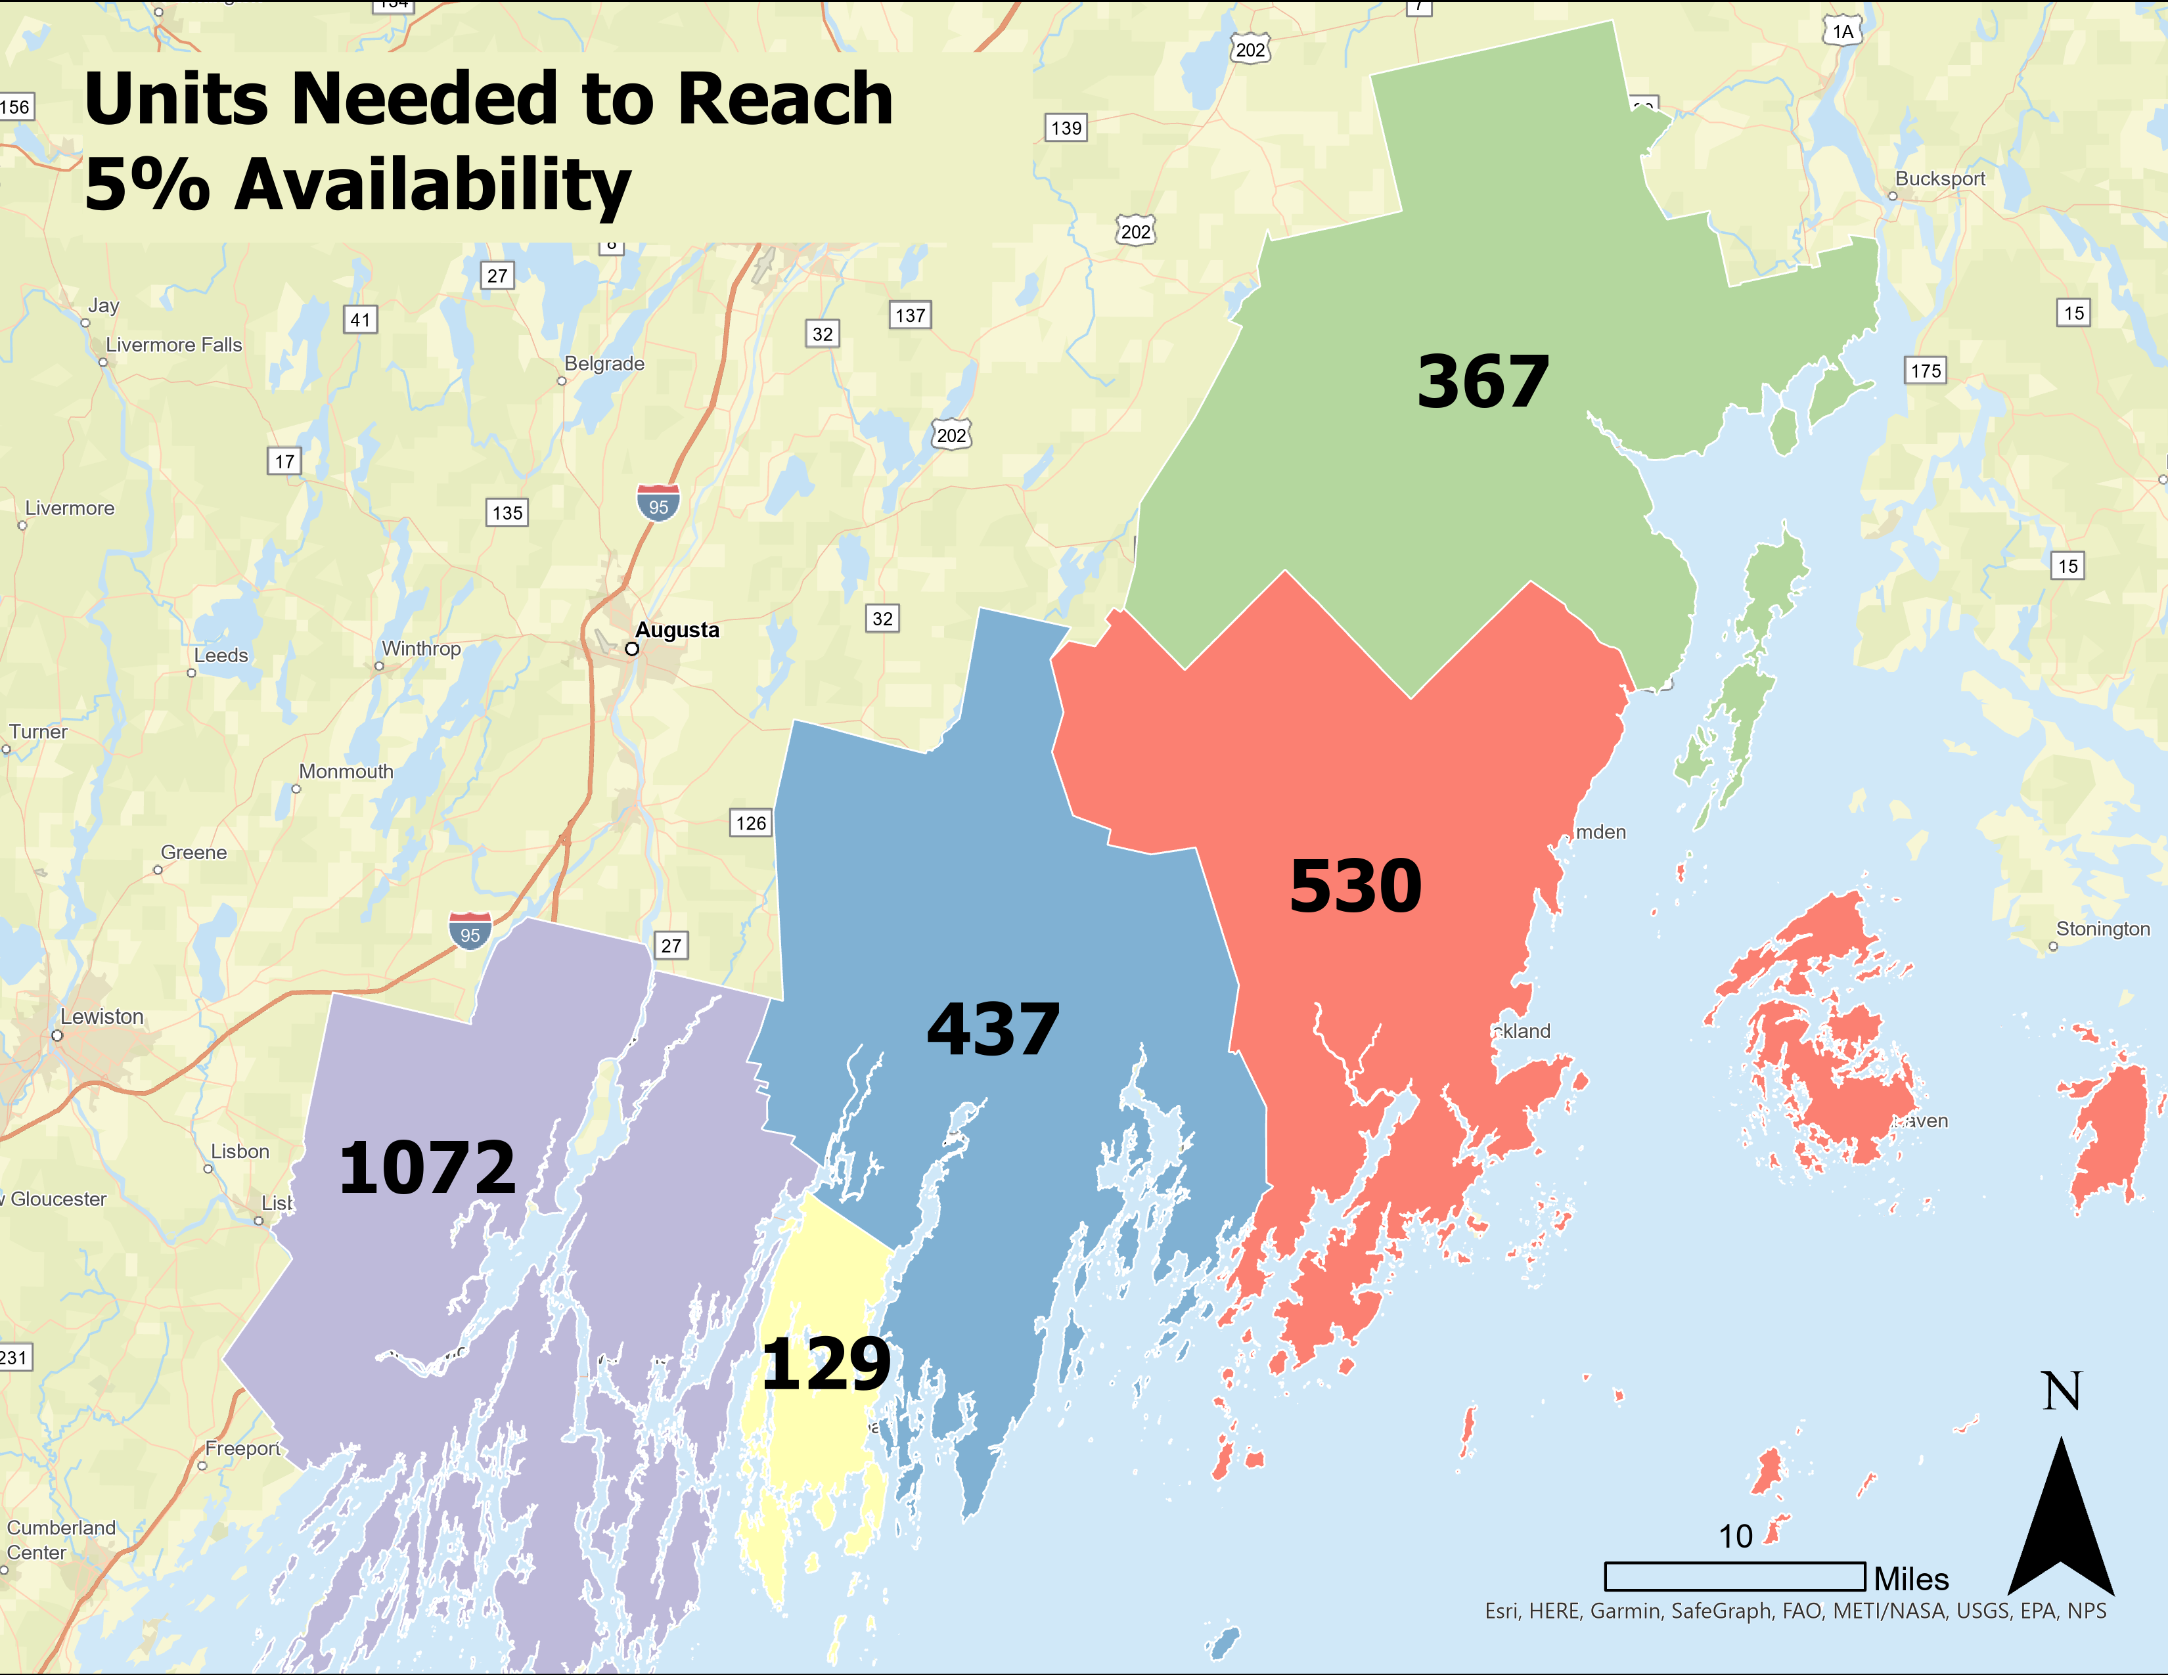
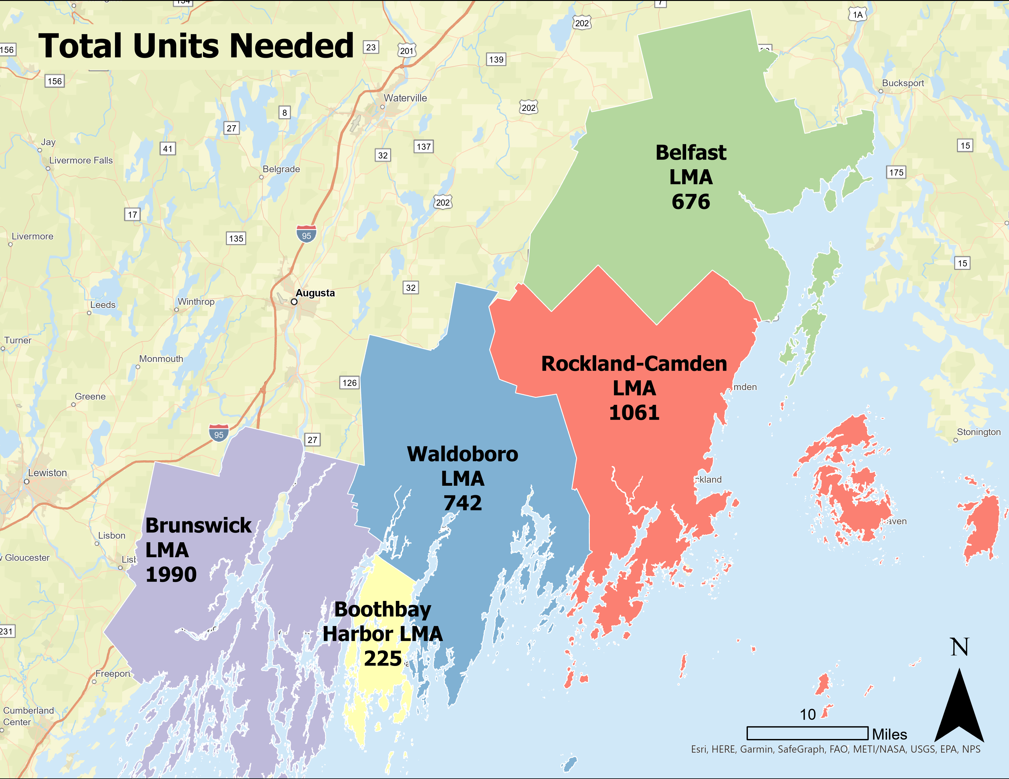
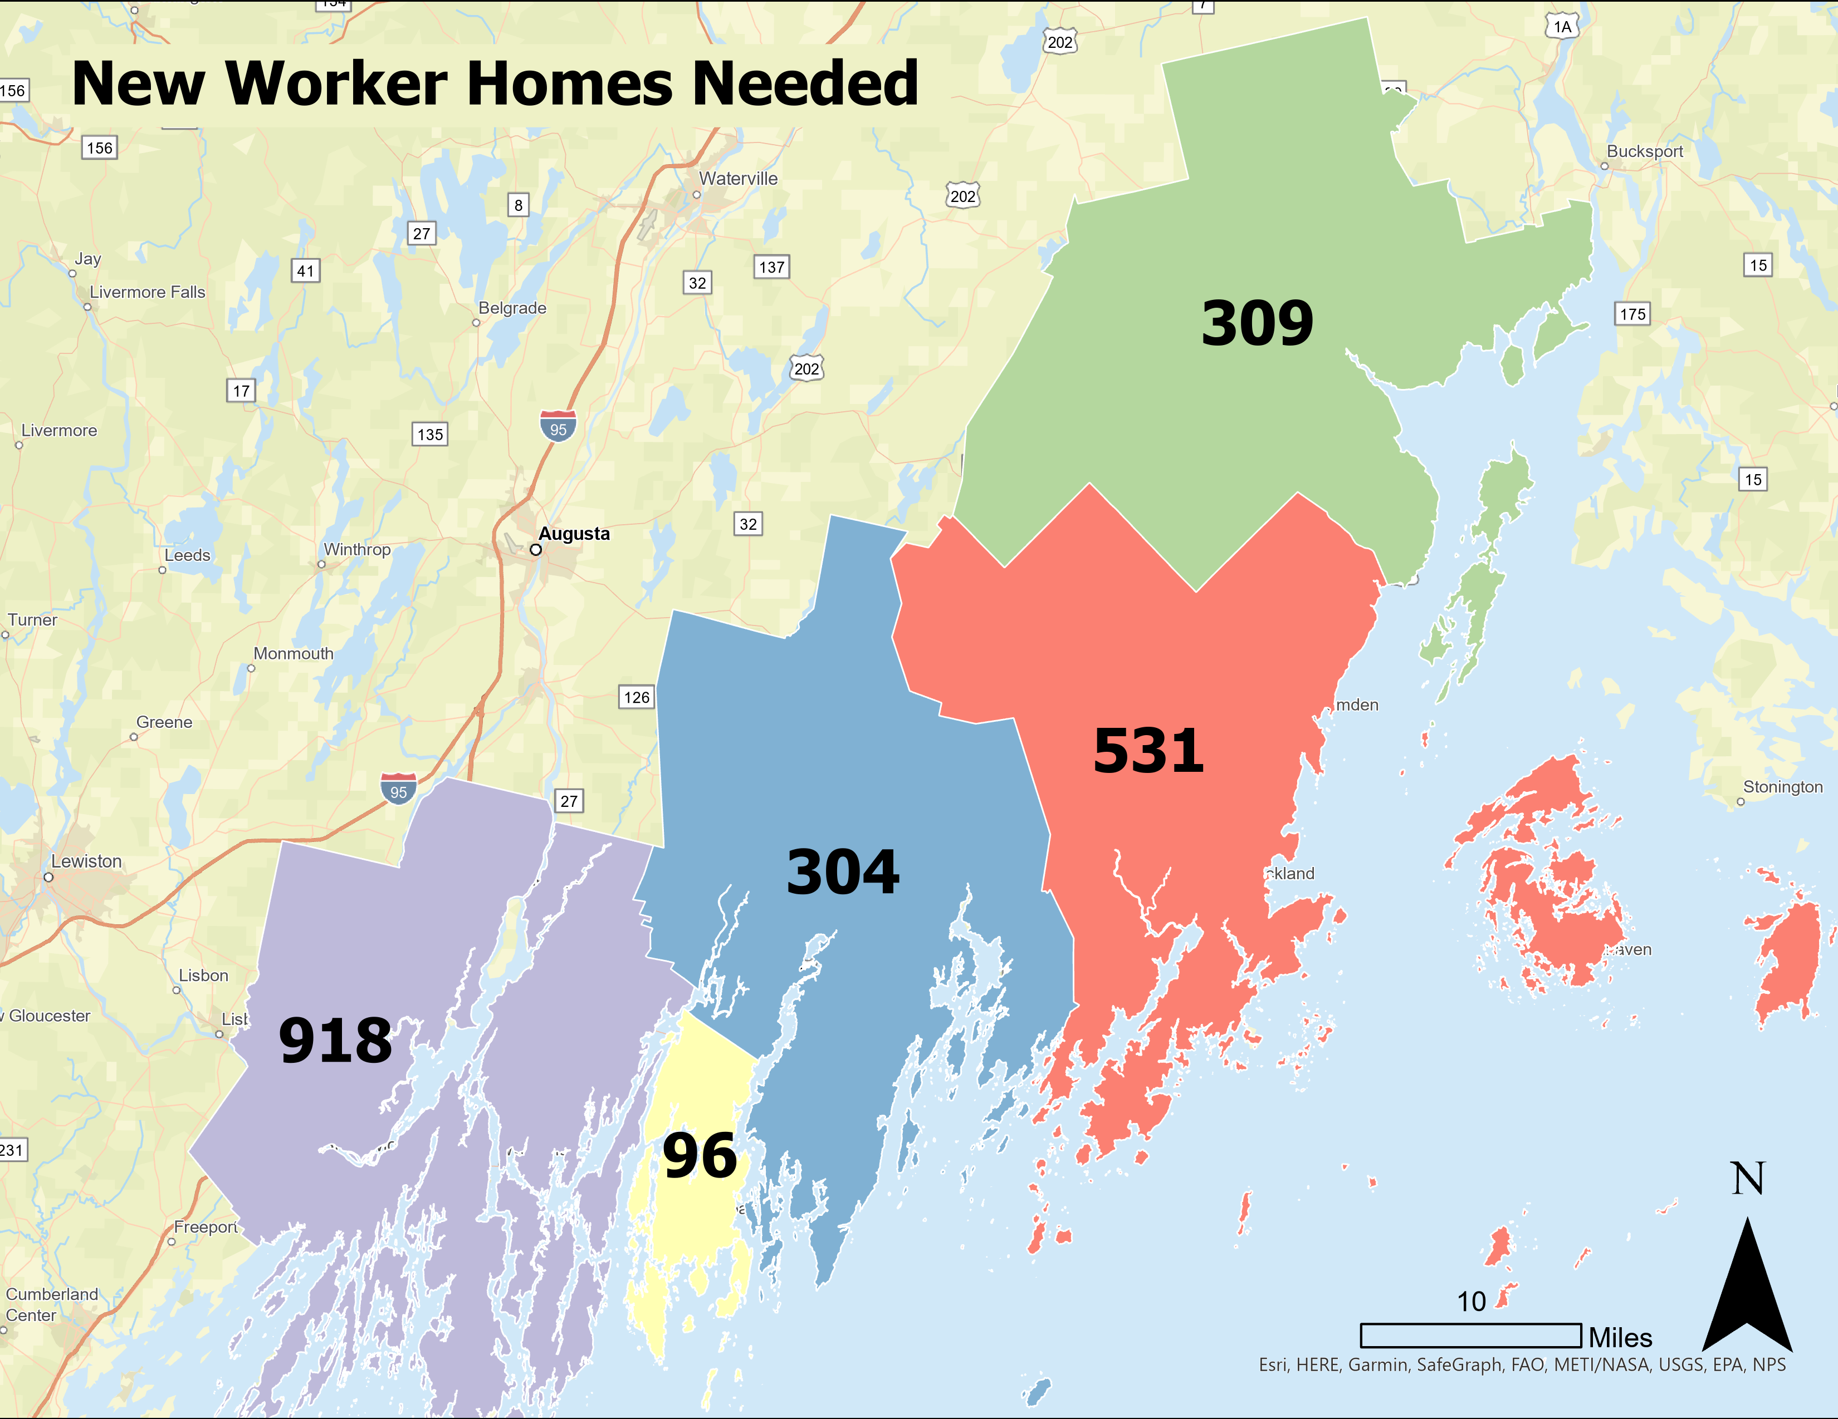
Housing Gap Analysis: Units Needed
: 4700

Slide 10
Housing Gap Analysis: Units Needed
Labor Market Area | New Worker Homes Needed (Jobs : Homes Ratio) | Units Needed to Reach 5% Availability | Total Units Needed
Brunswick LMA | 918 | 1072 | 1990
Boothbay Harbor LMA | 96 | 129 | 225
Waldoboro LMA | 304 | 437 | 742
Rockland-Camden LMA | 531 | 530 | 1061
Belfast LMA | 309 | 367 | 676
Total* | 2200 | 2500 | 4700
*Rounded to the nearest 50

Slide 11
Housing Gap Analysis: Income Distribution
Adjusted income brackets by the affordability index to account for greater need at lower levels of income
  Different approach from State of Maine Study
Income distribution
  Renters
  Homeowners
LMA | Brunswick LMA | Boothbay Harbor LMA | Waldoboro LMA | Rockland-Camden LMA | Belfast LMA
Less than 20K | 19% | 28% | 33% | 24% | 24%
20K - 35K | 13% | 8% | 14% | 19% | 19%
35K - 50K | 14% | 10% | 15% | 13% | 14%
50K - 75K | 16% | 17% | 13% | 16% | 12%
75K - 100K | 24% | 24% | 19% | 21% | 19%
100K - 150K | 8% | 8% | 6% | 5% | 7%
150K+ | 5% | 5% | 0% | 1% | 5%
Notes:
Collected data on income distribution on both renters and homeowners in the MCOG region
Adjusted income brackets by the affordability index to account for greater need at lower levels of income
The State of Maine Housing Production Needs Study distributed the housing unit shortage across income brackets, but the report noted that their study did not sufficiently represent the need at lower income brackets. Thus, the affordability index is used in our analysis to adjust the income brackets by the appropriate amount

Slide 12
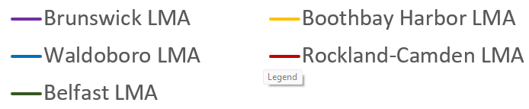
Housing Gap Analysis: Income Distribution

Slide 13
Number of Units Needed: Owned
 | Brunswick LMA | Boothbay Harbor LMA | Waldoboro LMA | Rockland-Camden LMA | Belfast LMA
Percent Owned | 75% | 80% | 79% | 79% | 78%
Less than 20K | 169 | 34 | 74 | 97 | 83
20K - 35K | 175 | 42 | 95 | 116 | 91
35K - 50K | 169 | 46 | 74 | 107 | 73
50K - 75K | 520 | 30 | 202 | 318 | 178
75K - 100K | 171 | 10 | 57 | 77 | 41
100K - 150K | 284 | 17 | 80 | 114 | 53
150K+ | 0 | 0 | 7 | 10 | 5
Total | 1487 | 179 | 589 | 840 | 524
Number of Units Needed: Rented
 | Brunswick LMA | Boothbay Harbor LMA | Waldoboro LMA | Rockland-Camden LMA | Belfast LMA
Percent Rented | 25% | 20% | 21% | 21% | 23%
Less than 20K | 116 | 15 | 61 | 53 | 51
20K - 35K | 80 | 6 | 33 | 42 | 29
35K - 50K | 77 | 6 | 15 | 36 | 19
50K - 75K | 133 | 13 | 34 | 38 | 36
75K - 100K | 52 | 2 | 6 | 39 | 6
100K - 150K | 42 | 3 | 3 | 12 | 11
150K+ | 4 | 0 | 0 | 2 | 1
Total | 504 | 45 | 153 | 222 | 153

Slide 14
Subregional Working Groups
Data is not as objective as we would like! Context is everything
Subregional groups:
  Five Rivers Region (Sagadahoc County, Brunswick, and Harpswell)
  Knox County
  Waldo County
Dug further into data, seasonal homes, short-term rentals, community insights

Slide 15
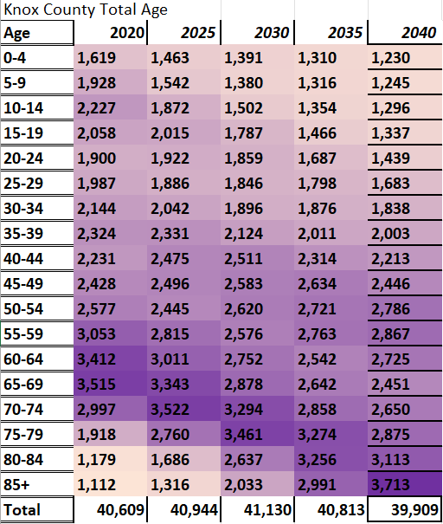

Slide 16
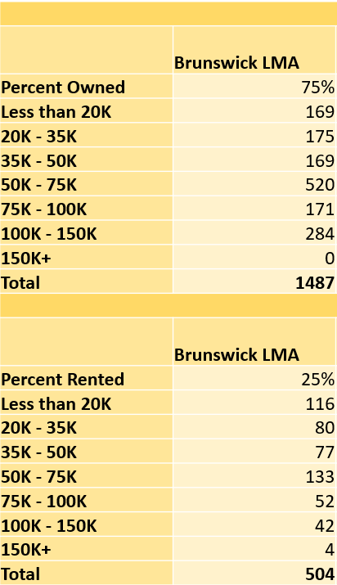
Town of Georgetown
Owned Homes
Housing Units: ~1K, ~2% of the Brunswick LMA
Brunswick LMA has a housing shortage of ~2000 units
Georgetown is dominated by seasonal homes, lack of rental homes, small development areas
Overall need: roughly 50-100 homes, 10-20 of which should be designated as low-income, and 40-80 should be designated as “Missing Middle”
Rented Homes

Slide 17
Town of Brunswick
Owned Homes
Housing Units: ~9K, ~25% of the Brunswick LMA
Brunswick LMA has a housing shortage of ~2000 units
Town of Brunswick should have AT LEAST 500 new units, have actually built 615 units since 2022, and have another ~500 in the pipeline
Balance between owned vs rented homes, low- vs middle- or high-income
Rented Homes
Notes:
2022-2024—615 new units, 4 times as many multifamily as single family
Inclusionary zoning for rental

Slide 18
Takeaways
Data is great! But it’s not everything
Each community is unique, affects surrounding communities
Use all your resources

Slide 19
Next Steps for MCOG
Update housing datasets:
  Summary data
  Gaps Analysis
Municipal survey
  How many units have been built
Continued work with communities

Slide 20
Thank you! Questions?
Contact
Charlotte Nutt
cnutt@midcoastcog.com

